Slide 1
CSAT Analytics Dashboard
Analyzing Customer Satisfaction to Improve Service Quality
Presented BY:
Prajwal r Patil
Certified Data Analyst (CDA-jan-05)
Register No: CA12202540402

Slide 2
Introduction
Customer Satisfaction Score (CSAT) is an important metric used to measure customer experience and service quality.
Organizations use CSAT analysis to understand customer feedback, identify service gaps, and improve customer interactions.
This project focuses on analyzing customer satisfaction data using Power BI to identify trends, measure performance, and generate insights through interactive dashboards.
The analysis helps businesses make data-driven decisions to enhance customer satisfaction and operational efficiency.

Slide 3
Project Overview
The CSAT analytics dashboard project aims to analyze customer satisfaction data and identify factors affecting customer experience.
This project uses power BI to transform raw customer interaction data into meaningful visual insights through dashboards and kpis.
The dashboard helps monitor customer satisfaction trends, analyze call patterns, and support better business decision-making.

Slide 4
Objectives
• Analyze customer satisfaction trends and customer feedback patterns
• Create an interactive dashboard using Power BI
• Monitor customer interaction and call performance metrics
• Identify factors affecting customer satisfaction scores
• Generate meaningful insights through data visualization
• Support data-driven decision making for service improvement

Slide 5
Motivation for Choosing the Dataset
Why This Dataset?
Customer Satisfaction plays an important role in business success and customer retention.
This dataset was chosen to understand customer behavior, analyze service quality, and identify factors affecting customer satisfaction.
Working with this dataset provides real-world experience in data analysis, visualization, and business intelligence using Power BI.
Reasons for Selecting This Dataset:
• Helps understand customer expectations and feedback
• Useful for analyzing service performance
• Provides real-world business problem-solving experience
• Improves dashboard development and analytics skills
• Supports data-driven decision making

Slide 6
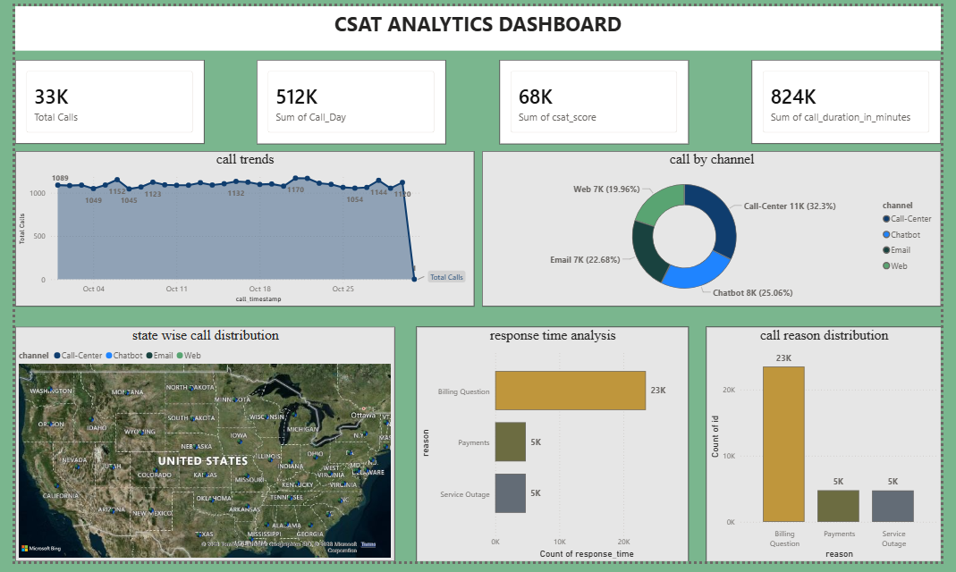
dashboard

Slide 7
Methodology / Project Process
Step 1: Data Collection
• Imported customer satisfaction dataset into Power BI
Step 2: Data Cleaning
• Removed null values
• Corrected date formats
• Fixed data type errors
Step 3: Data Transformation
• Used Power Query for preprocessing
• Created calculated columns and measures
Step 4: KPI Creation
• Total Calls
• CSAT Score
• Satisfaction %
• Average Response Time
Step 5: Dashboard Development
• Created visualizations and interactive reports
Step 6: Analysis & Insights
• Identified trends and generated recommendations

Slide 8
Dashboard Overview
The dashboard was developed using Power BI to visualize customer satisfaction metrics and customer interaction patterns. Multiple charts and KPI cards were used to provide meaningful insights and improve decision-making.
Dashboard Components:
• KPI Cards for performance metrics • Map Visualization for state-wise analysis
• Line Chart for call trends analysis • Bar Charts for category comparison
• Doughnut Chart for channel distribution • Interactive filters and slicers

Slide 9
Key Insights
• Customer satisfaction scores showed an increasing trend over time
• Phone channel handled the highest number of customer interactions
• Faster response times resulted in better satisfaction scores
• Some states showed higher customer engagement compared to others
• Premium customer segments had higher satisfaction levels
• Peak call volumes were observed on specific weekdays

Slide 10
Recommendations
• Reduce customer response time to improve satisfaction levels
• Focus on improving low-performing communication channels
• Increase support resources during peak call periods
• Monitor customer feedback regularly for continuous improvement
• Use dashboard insights for better business decisions

Slide 11
Conclusion
The CSAT analytics dashboard successfully transformed raw customer data into meaningful insights using power BI. The project helped analyze customer satisfaction trends, identify performance gaps, and support data-driven decision making for improving customer experience and service quality.

Slide 12
Thank you

